Slide 1
Energetic Particles at Interplanetary Shocks
Liam David
Mentor: Dr. Federico Fraschetti
University of Arizona Space Grant

Slide 2
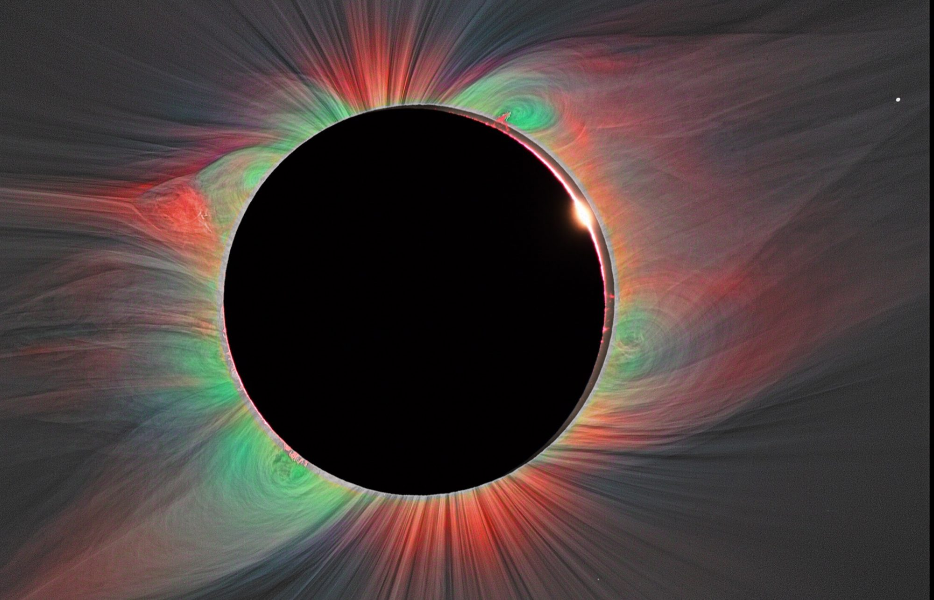
Solar Wind and Shocks
Sun generates ionized wind
Protons, helium, electrons
Outward radial speed ~400-800km/s
Density ~5/cm³
Temperature ~10⁵K
Shocks
Solar flares, coronal mass ejections
Jump in density, temperature, magnetic field
Collisionless – electromagnetic coupling
Speed ~400 – 2000km/s
https://project.ifa.hawaii.edu/solarwindsherpas/wp-content/uploads/sites/2/2017/07/cropped-Tse2008.jpg

Slide 3
Shock Structure and Energy Components
Sonic Mach number M_{S}
Alfvén Mach number M_{A}
Magnetic field – normal angle θ_{Bn}
Shocks transfer energy
Magnetic energy density
Gas pressure (thermal)
Energetic particles (non-thermal)
Interested in energetic particles
Upstream
plasma
θ_{Bn}
Normal
Shock
Magnetic
field
Downstream
plasma

Slide 4
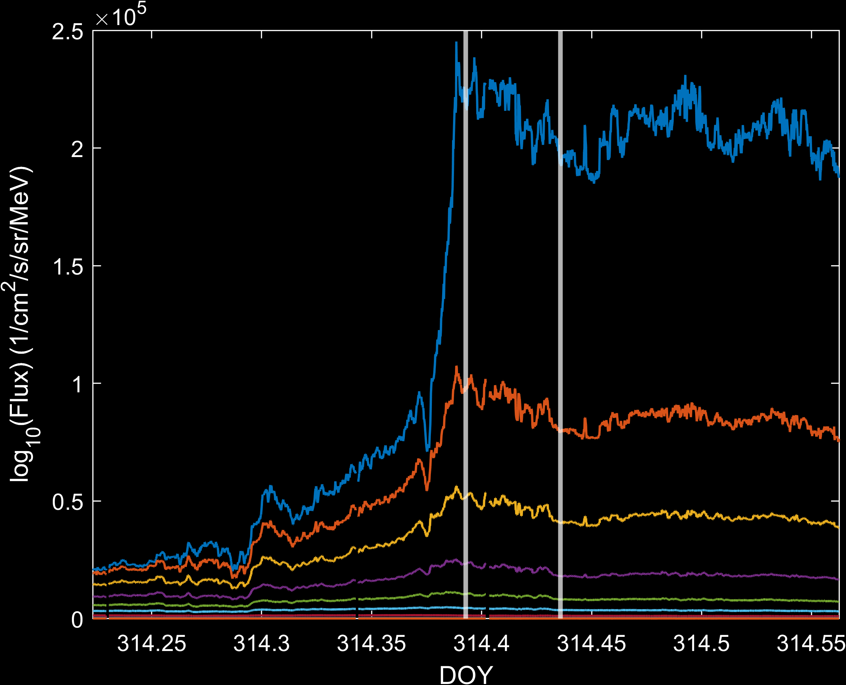
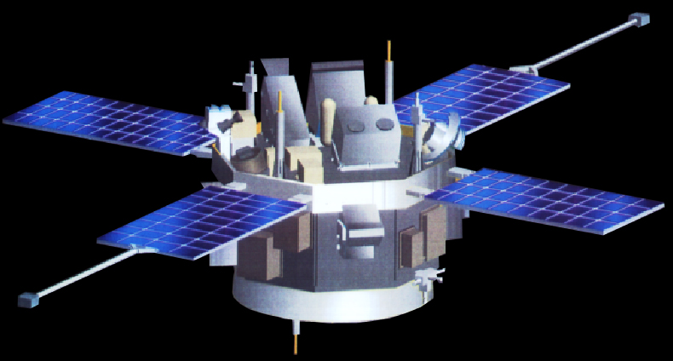
Measurement
Spacecraft at 1AU
ACE
Wind
CfA Database
Preprocessed shock selection
Shock speed, plasma temperature, etc.
Shock selection criteria
Range of θ_{Bn} and M_{A}
Clean particle flux profile
Assume isotropic protons
Average for one hour
Downstream only
https://www.nasa.gov/images/content/681689main_spacecraft.jpg

Slide 5
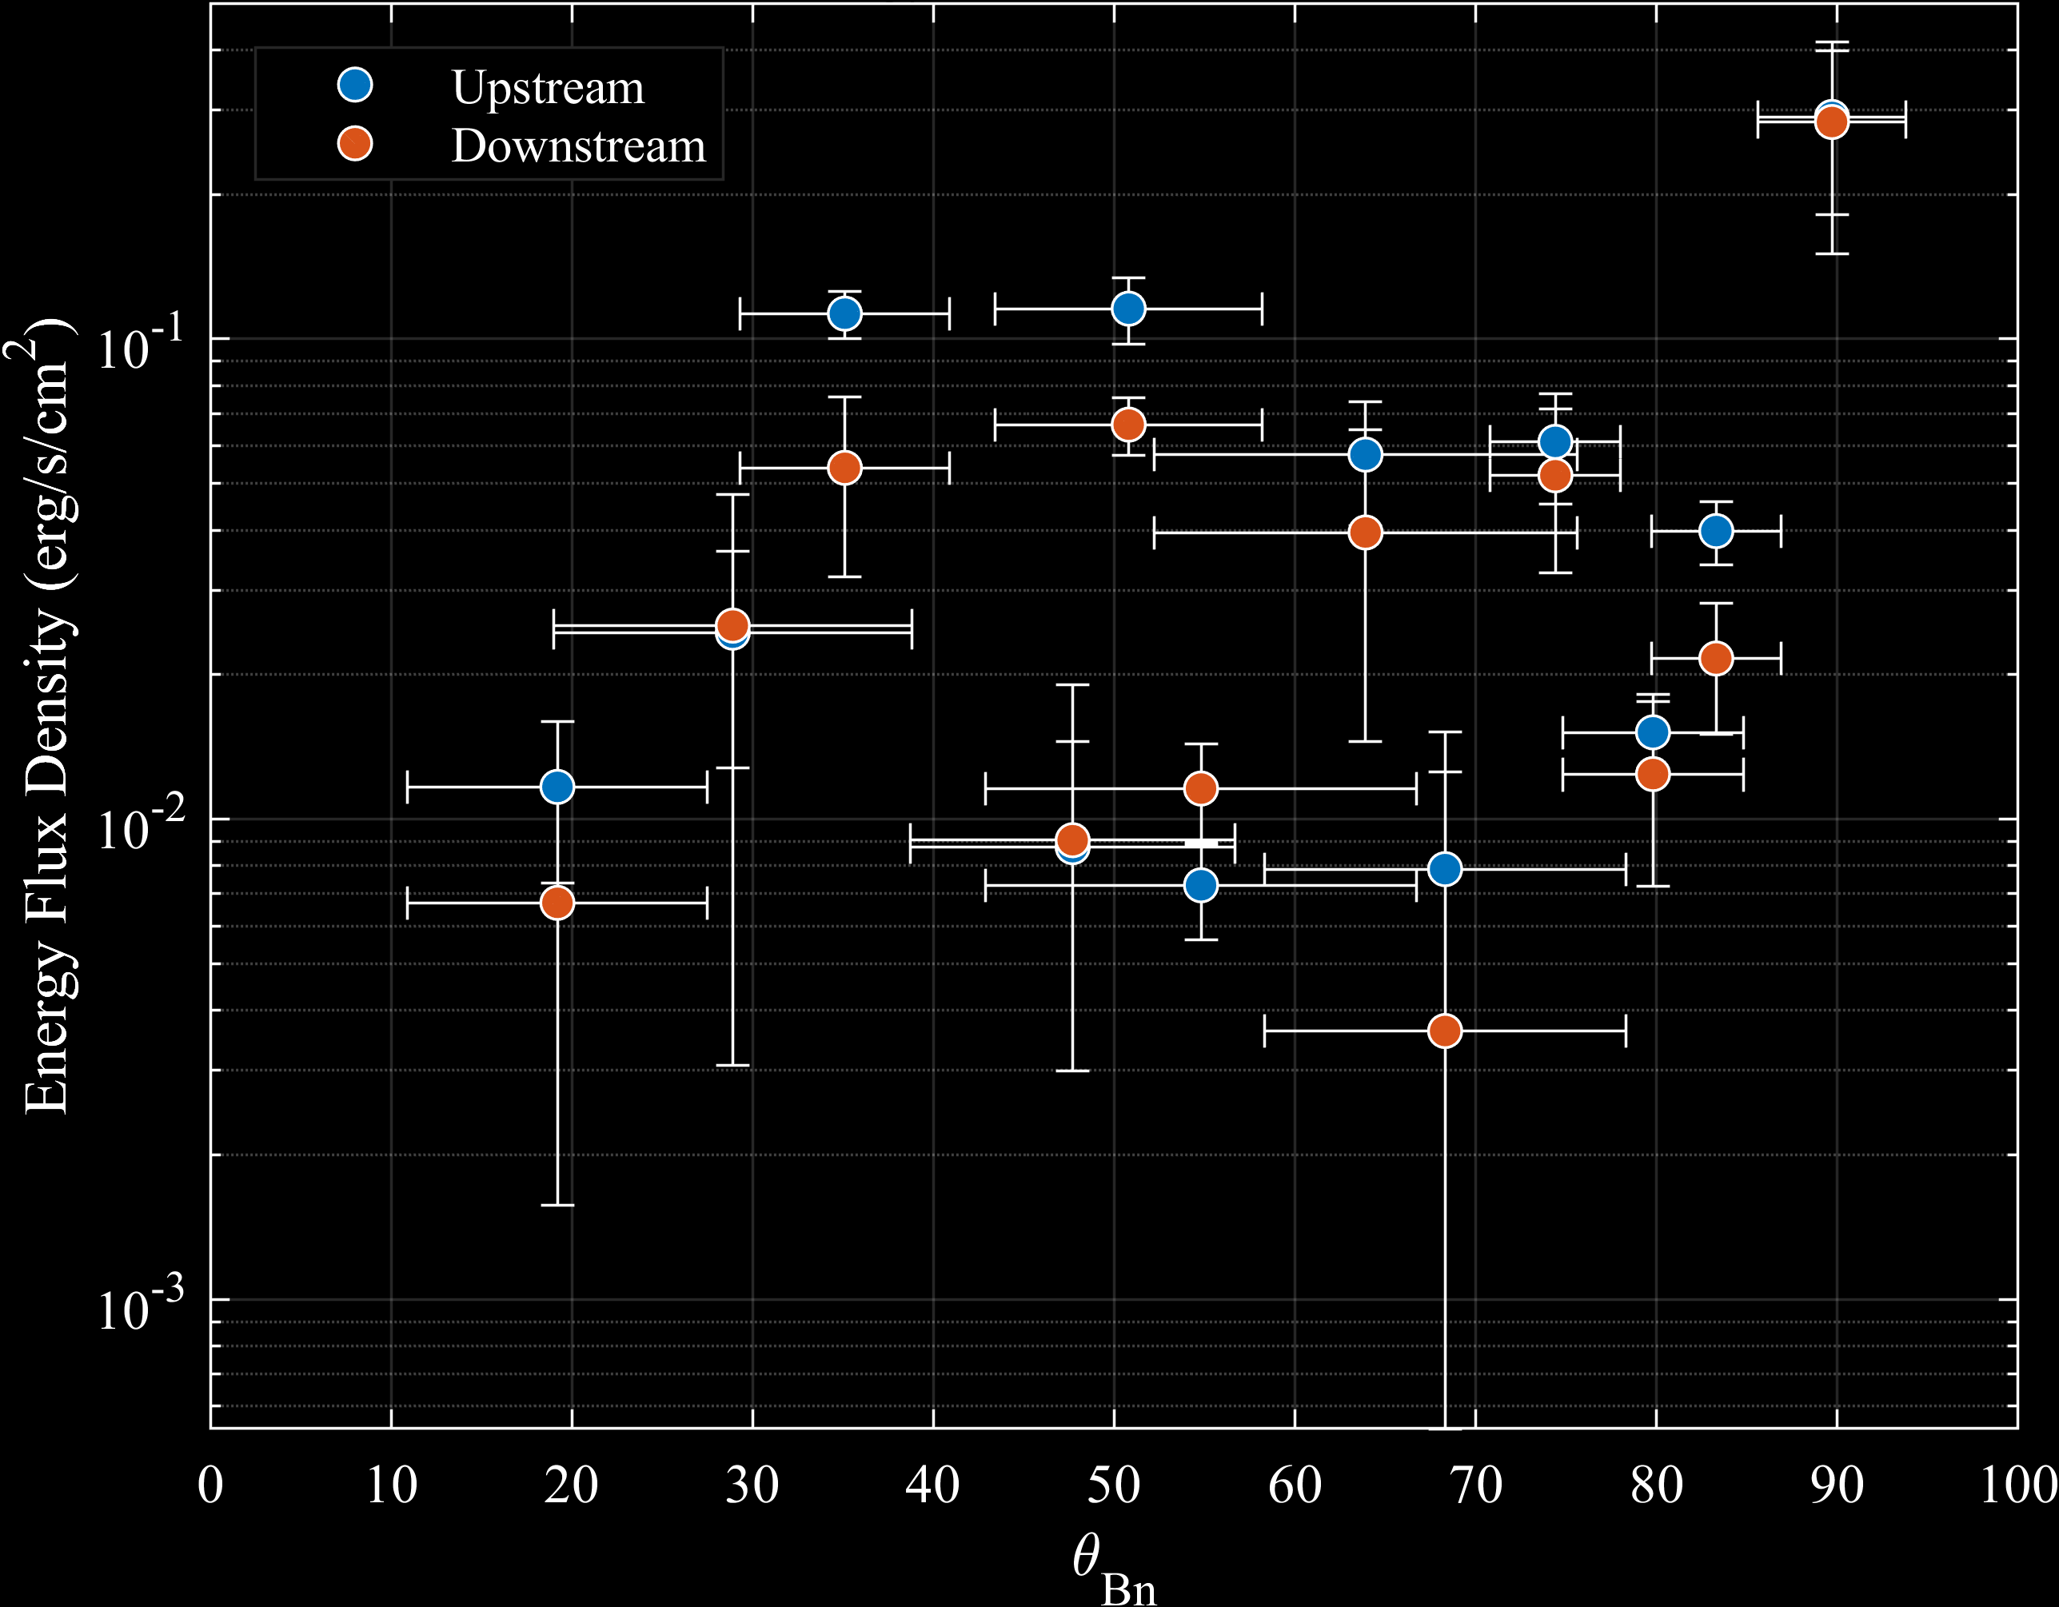
Energy Conservation
Energy conserved within 1σ errors – usually
Upstream consistently larger
Missing energy components
Electrons
Heavy ions
Reflected ions
Waiting on SWICS instrument data

Slide 6
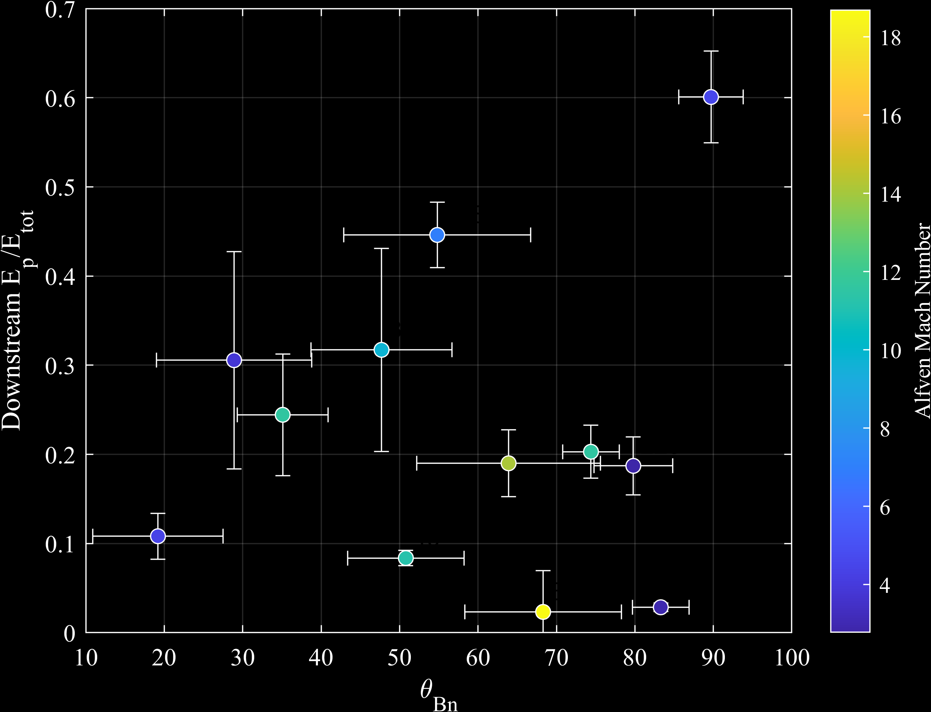
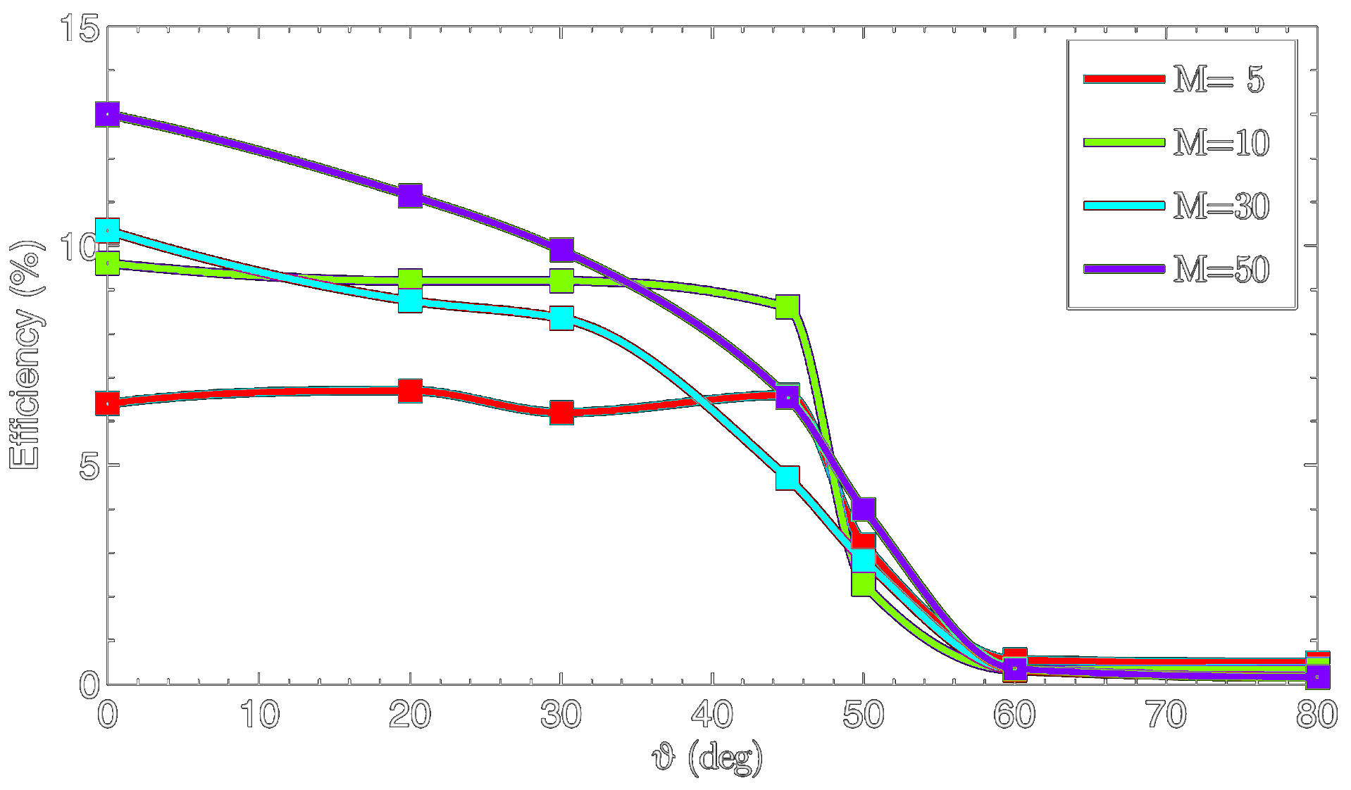
Particle Energy Fraction
Spread in downstream fraction
Bulk within 15%-35%, mean 25%
Uncorrelated with θ_{Bn} and M_{A}
Confirms other shock observations
Disagrees with simulations that do not include pre-existing turbulence
Caprioli & Spitkovski 2014
Pohl, Hoshino, and Niemiec 2019. arXiv:1912.02673v1

Slide 7
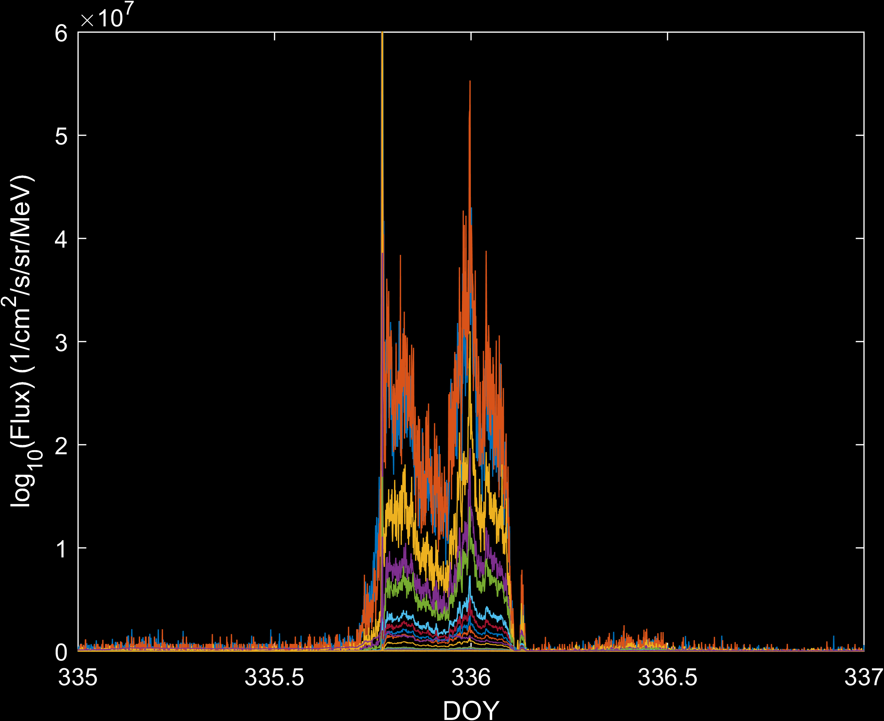
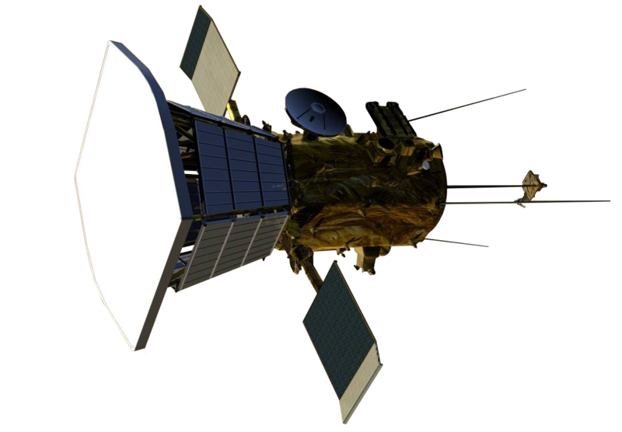
Conclusions
Energetic particles constitute significant downstream energy fraction
Shock dynamics complicate energy conservation
Reflected particles
Anisotropy
Recent Parker Solar Probe shock
Close to sun – 0.15Au
https://www.whereisroadster.com/icon/PSP.png

Slide 8
Acknowledgements
Federico Fraschetti
Joe Giacalone
Lars Berger
Robert Wimmer-Schweingruber
David Lario
NASA Space Grant Consortium

Slide 9
Thank You

